Slide 1
Automatic Ship Classification from Optical Aerial Images Using Deep Learning DATS 6303 - Project
Akhil Bharadwaj, Shumel Siraj
Group-2

Slide 2
Background and motivation
The rapid growth of remote sensing technologies using satellite images has helped in building surveillance and security systems for water bodies.
Maritime monitoring is essential for many government bodies to catch hold of any criminal activities happening in international waters.
Many illegal activities like unlawful fishing, hijacking of ships, encroachment of sea borders, illicit exchange of sea cargo, accidents, and military attacks.
The traditional manual approach to ship classification is time-consuming, expensive, and error-prone, which limits its effectiveness in real-time applications.
Therefore, the development of an automated ship classification system using deep learning techniques has the potential to revolutionize the way we monitor and manage maritime activities.

Slide 3
Deep learning for remote sensing images
Deep learning techniques have been increasingly used in remote sensing applications to classify images or detect objects.
Automated ship classification from optical aerial images using deep learning techniques has several potential applications.
For example, it can be used to monitor illegal fishing activities, track the movement of cargo ships, and detect oil spills or other environmental hazards.
Moreover, it can also assist in search and rescue operations by identifying distressed vessels in the open sea.
Overall, the development of an automated ship classification system using deep learning techniques has the potential to significantly improve our ability to monitor and manage maritime activities, making it an important area of research in the field of computer vision and remote sensing.

Slide 4
About the dataset
The dataset MASATI (MAritime SATellite Imagery dataset) provides maritime scenes of optical aerial images from the visible spectrum. The dataset can be found on the Kaggle website.
The MASATI dataset contains colour images in dynamic marine environments, and it can be used to evaluate ship detection methods. Each image may contain one or multiple targets in different weather and illumination conditions.
The dataset is composed of 6212 satellite images labelled according to the following seven classes: land, coast, sea, ship, multi, coast-ship, and detail. In general, the average image size has a spatial resolution of around 512 x 512 pixels. The images are stored as PNG where pixel values represent RGB colours.
The distance between targets and the acquisition satellite has also been changed to obtain captures at different altitudes.

Slide 5
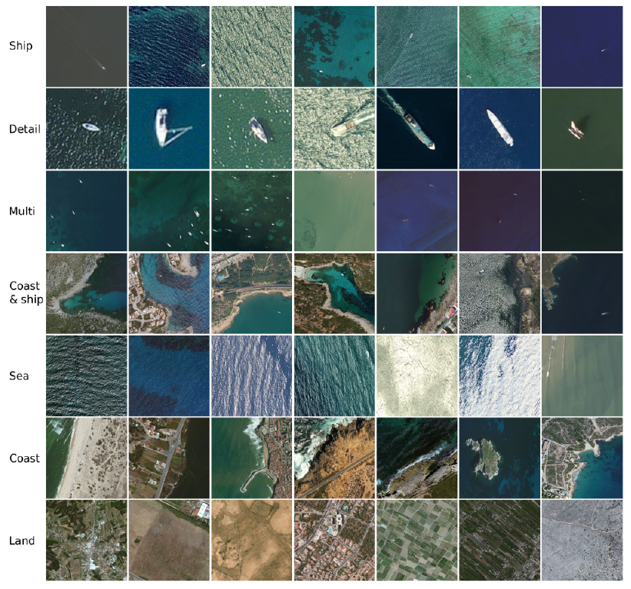
Sample images

Slide 6
Sample distribution of the dataset
The next table shows the sample distribution for each class:
Main class Sub-class Samples Description
Ship Ship 1015 Sea with a ship (no coast).
Detail 1789 Ship details.
Multi 188 Multiple ships.
Coast & ship 121 Coast with ships.
Non-ship Sea 1010 Sea (no ships).
Coast 1054 Coast (no ships).
Land 1035 Land (no sea).

Slide 7
Pre-processing
Image augmentation techniques, such as rotation by 45 degrees, zooming, horizontal and vertical flipping, were applied to the images, and images were resized to a size of 100 pixels.
The pre-processed images were then saved as NumPy arrays using the pickle module.
To balance the dataset, the class weight parameter was used during training.

Slide 8
Transfer learning
A teacher has years of experience in the topic he/she teaches. With all this accumulated information, the lectures that students get are a concise and brief overview of the topic. So, it can be seen as a “transfer” of information from the learned to a novice.
Keeping in mind this analogy, we compare this to the neural network. A neural network is trained on data. This network gains knowledge from this data, which is compiled as “weights” of the network. These weights can be extracted and then transferred to any other neural network. Instead of training the other neural network from scratch, we “transfer” the learned features.
“Transfer Learning” which enables us to use pre-trained models from other people by making small changes.

Slide 9
Pre-trained models
One should be very careful while choosing what pre-trained model you should use in your case. If the problem statement, we have at hand is very different from the one on which the pre-trained model was trained – the prediction we would get would be very inaccurate. For example, a model previously trained for speech recognition will work horribly if we try to use it to identify objects using it.
We are lucky that many pre-trained architectures are directly available for us in the Keras library. ImageNet data set has been widely used to build various architectures since it is large enough (1.2M images) to create a generalized model. The problem statement is to train a model that can correctly classify the images into 1,000 separate object categories. These 1,000 image categories represent object classes that we come across in our day-to-day lives, such as species of dogs, cats, various household objects, vehicle types etc.

Slide 10
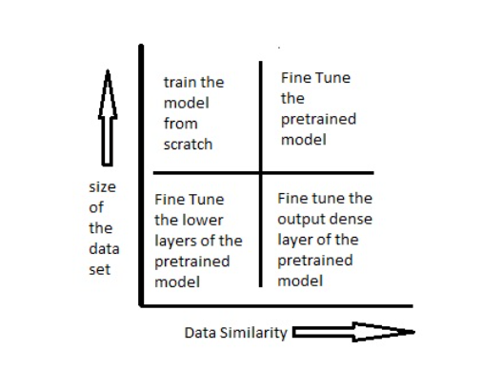
Methodology for transfer learning

Slide 11
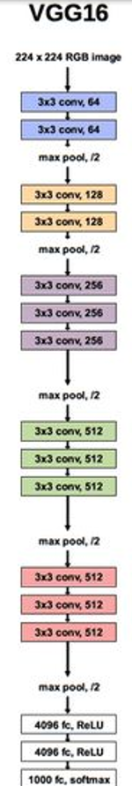
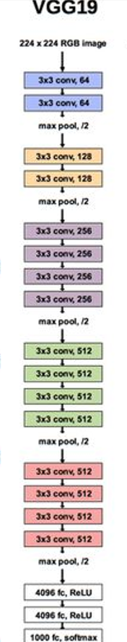
VGG16 and VGG19
VGG which is from VGG Group, Oxford, had two versions, one with 16 layers and another with 19 layers.
This model differed from previous high-performing models in several ways. First, it used a tiny 3×3 filter with a 1-pixel stride, for comparison, Alex Net used an 11×11 filter with a 4-pixel stride.
Second, VGG uses a smaller convolutional filter, which reduces the network’s tendency to over-fit during training exercises. A 3×3 filter is the optimal size because a smaller size cannot capture left-right and up-down information.

Slide 12
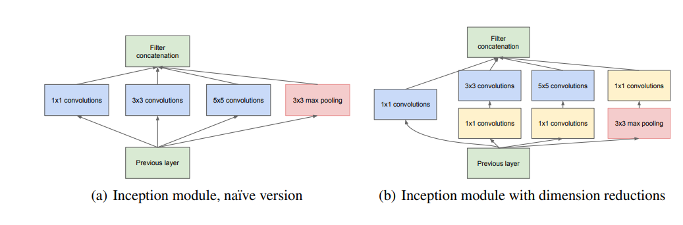
Inception
Inception is notable for its use of the Inception module, which consists of multiple parallel convolutional layers with different filter sizes, followed by a pooling layer, and concatenation of the outputs.
This design allows the network to learn features at multiple scales and resolutions, while keeping the computational cost manageable.
The network also includes auxiliary classifiers at intermediate layers, which encourage the network to learn more discriminative features and prevent overfitting.
Inception also builds upon the ideas of previous convolutional neural networks, including LeNet, which was one of the first successful applications of deep learning in computer vision.

Slide 13
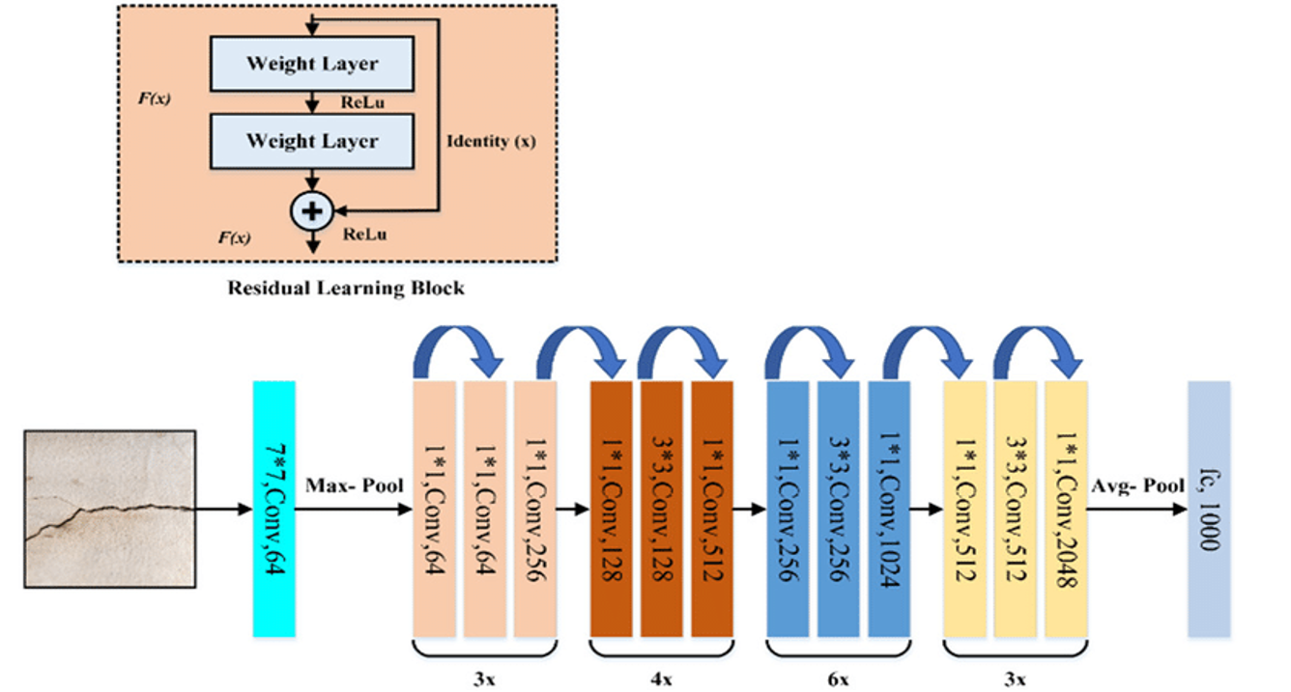
ResNet
The Residual Network (ResNet) architecture uses the concept of skip connections, allowing inputs to “skip” some convolutional layers. The result is a significant reduction in training time and improved accuracy.
After the model learns a given feature, it won’t attempt to learn it again—instead, it will focus on learning the new features.
The 50-layer ResNet uses a bottleneck design for the building block. A bottleneck residual block uses 1×1 convolutions, known as a “bottleneck”, which reduces the number of parameters and matrix multiplications. This enables much faster training of each layer. It uses a stack of three layers rather than two layers.

Slide 14
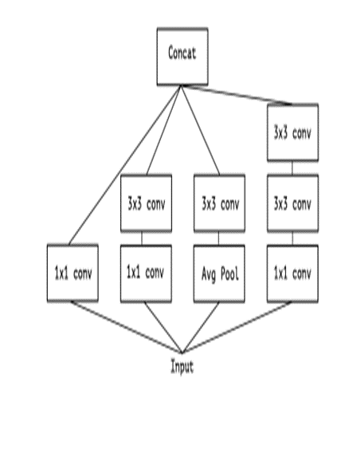
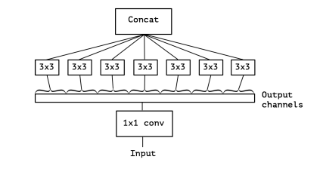
Xception
• Xception is an extension of the inception Architecture which replaces the standard Inception modules with depth-wise Separable Convolutions.
• Xception stands for “extreme inception”, it takes the principles of Inception to an extreme. In Inception, 1x1 convolutions were used to compress the original input, and from each of those input spaces we used different types of filters on each of the depth spaces. Xception just reverses this step.
• It first applies the filters on each of the depth maps and then finally compresses the input space using 1X1 convolution by applying it across the depth.

Slide 15
CNN model
The first layer is a Conv2D layer with 64 filters of size 3x3 and a ReLU activation function.
A BatchNormalization layer is added to normalize the output of the previous layer.
A MaxPooling2D layer with a pool size of 2x2 is added to downsample the output of the previous layer.
A second Conv2D layer with 32 filters of size 3x3 and a ReLU activation function is added.
Another BatchNormalization layer is added to normalize the output of the second Conv2D layer.
Another MaxPooling2D layer with a pool size of 2x2 is added to downsample the output of the second Conv2D layer.
The output of the second MaxPooling2D layer is flattened.
A Dense layer with 128 units and a ReLU activation function is added, along with a kernel_regularizer of L2 regularization with a rate of 0.01.
A Dropout layer with a rate of 0.5 is added to reduce overfitting.
Another Dense layer with 64 units and a ReLU activation function is added, followed by another Dropout layer with a rate of 0.5.
Finally, a Dense layer with 7 units and a softmax activation function is added to produce the output.

Slide 16
Fine-tuning the pretrained models
Flatten layer: This layer is used to flatten the output of the pre-trained VGG16 model to a one-dimensional array before passing it to the fully connected layers.
L2 regularization with a coefficient of 0.01.
Batch Normalization layer: This layer is added to normalize the outputs and prevent overfitting.
Dropout layer: This layer is used to randomly drop out 50% of the nodes in the dense layer during training to prevent overfitting.

Slide 17
CNN KNN
Train a CNN on the training dataset to learn a feature representation for each image.
Extract the feature representation (neural code) for each image from the last convolutional layer of the CNN.
Train a KNN classifier on the neural codes of the training dataset.
This approach result in improved performance, reduced training time and easy interpretation.

Slide 18
Results
Model | Dataset | Accuracy | F1 Score | Recall | Precision
CNN model | Validation | 0.61 | 0.604 | 0.619 | 0.656
 | Train | 0.68 | 0.662 | 0.682 | 0.719
 | Test | 0.62 | 0.614 | 0.628 | 0.659
VGG16 | Validation | 0.77 | 0.767 | 0.776 | 0.764
 | Train | 0.80 | 0.851 | 0.812 | 0.811
 | Test | 0.78 | 0.775 | 0.784 | 0.772
VGG19 | Validation | 0.77 | 0.765 | 0.776 | 0.758
 | Train | 0.80 | 0.797 | 0.805 | 0.805
 | Test | 0.76 | 0.765 | 0.776 | 0.767
Inception | Validation | 0.73 | 0.724 | 0.794 | 0.795
 | Train | 0.79 | 0.793 | 0.794 | 0.795
 | Test | 0.70 | 0.698 | 0.704 | 0.703
ResNet50 | Validation | 0.47 | 0.457 | 0.478 | 0.487
 | Train | 0.55 | 0.526 | 0.550 | 0.529
 | Test | 0.45 | 0.425 | 0.454 | 0.452
Xception | Validation | 0.74 | 0.730 | 0.740 | 0.727
 | Train | 0.78 | 0.772 | 0.782 | 0.790
 | Test | 0.72 | 0.707 | 0.720 | 0.726

Slide 19
Limitations
Most instances are correctly classified, and the errors are only caused by confusion between Ship and Sea, as well as between Coast and Coast & Ship.
Ship and Sea samples are very similar since, in general, the size of the ships is very small, and it could cause a bad classification.
The same occurs with Coast and Coast & Ship classes.

Slide 20
Further improvements
Model optimization: Exploring different model architectures, hyperparameters, and training strategies could potentially lead to even better performance.
Feature extraction and fusion: Combining features from multiple pre-trained models or leveraging additional information from satellite images, such as spectral or temporal features, could enhance the model's performance in ship classification tasks.
Utilizing GANs: Employing Generative Adversarial Networks (GANs) to generate images for balancing the minority class in the dataset.

Slide 21
References
Feng, Y., Diao, W., Sun, X., Yan, M., & Gao, X. (2019, August 14). Towards automated ship detection and category recognition from high-resolution aerial images. MDPI. Retrieved April 20, 2023, from https://www.mdpi.com/2072-4292/11/16/1901
J. Alghazo, A. Bashar, G. Latif and M. Zikria, "Maritime Ship Detection using Convolutional Neural Networks from Satellite Images," 2021 10th IEEE International Conference on Communication Systems and Network Technologies (CSNT), Bhopal, India, 2021, pp. 432-437, doi: 10.1109/CSNT51715.2021.9509628.
Szegedy, C., Liu, W., Jia, Y., Sermanet, P., Reed, S., Anguelov, D., Erhan, D., Vanhoucke, V., & Rabinovich, A. (2014, September 17). Going deeper with convolutions. arXiv.org. Retrieved April 25, 2023, from https://arxiv.org/abs/1409.4842
Deep residual learning for image recognition - arxiv. (n.d.). Retrieved April 25, 2023, from https://arxiv.org/pdf/1512.03385.pdf
Chollet, F. (2017, April 4). Xception: Deep learning with depthwise separable convolutions. arXiv.org. Retrieved April 25, 2023, from https://arxiv.org/abs/1610.02357

Slide 22
Thank you

